Slide 1

Distributed Replicated Relational Database System for Vital Event : Birth Registration
A Report Presented to:
American College of Technology
Department of Computer Science Master’s Program
By
Natnael Makonnen, Yoseph Abebe, Robel Morka, Hanan Temam
Supervisor
Natnael Argaw (Ph.D.)
[Sep 2023] Addis Ababa, Ethiopia

Slide 2
Introduction
Digitalization that applies innovations and appropriate technological solutions enables civil registration and vital statistics (CRVS) systems to perform efficiently. Digitalization would support transformation and game changer of CRVS systems from the current practice of collecting, storing, retrieving, maintaining, compiling reports, and securing primary citizen data in multiple government ministries, departments, and agencies in silos to an integrated system that generates a single digital identity for individuals.
The full CRVS end to end solution is very wide and is out of our scope. Our proposal only focuses on birth registration on a distributed replicated relational database system environment. Our team will engage with ESS, RRS, UNHCR in requirement analysis, designing and implementation of Distributed Replicated Relational Database System for Vital Event Birth Registration (DRRDS-VEBR).
Scope

Slide 3

Problem Statement
ICS is a federal service providing organization that supports regions and city administration with total registration offices of more than 20,000, Ethiopian shipping lines, ministry of defence, refugee and returnee service and embassy and consular services abroad Ethiopia in about 52 countries worldwide. Birth Registration data is currently stored in a variety of disparate systems, which makes it difficult to access and manage.
This has resulted in the following problems.
• Inefficient Birth Registration operations
• Ineffective Birth Registration decision-making

Slide 4
Technology
Oracle Database (21C XE): The Oracle Database will be used to store Birth Registration data.
• Oracle Application Express (APEX: 23): Oracle Application Express will be used to develop the Birth Registration user interface.
• SymmetricDS: Software that will be used for replication of each distributed nodes

Slide 5
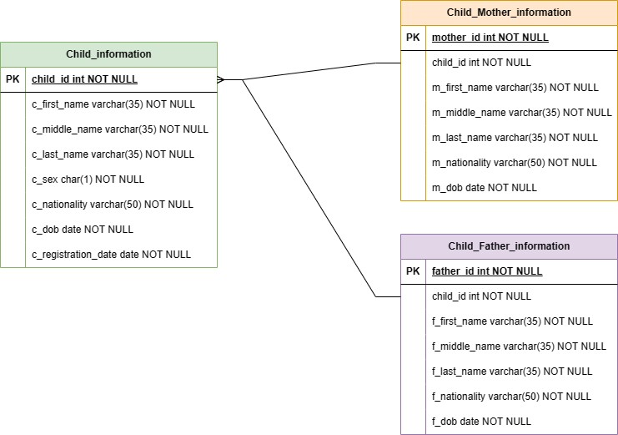
Technical Overview
Constraints and Relationships
Child_Information Table Structure
Column | Type | Null | Key | Check | Default
child_id | int(18) | No | PRI |  | NULL
c_first_name | Varchar(35) | No |  |  | NULL
c_middle_name | Varchar(35) | No |  |  | NULL
c_last_name | Varchar(35) | No |  |  | NULL
c_sex | Char(1) | No |  | “M” or “F” | NULL
c_nationality | Varchar(50) | No |  |  | NULL
c_dob | Date | No |  |  | NULL
c_registration_date | Date | No |  |  | SYSDATE

Slide 6
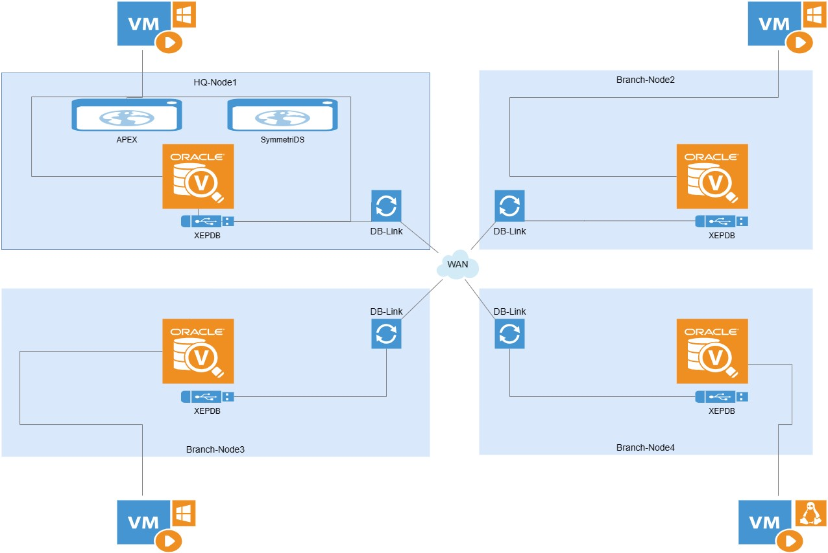
Data Model
Relational database management system (RDBMS)

Slide 7
Data Partitioning Strategy
• Current Birth
• late Birth
• Delayed Birth

Slide 8
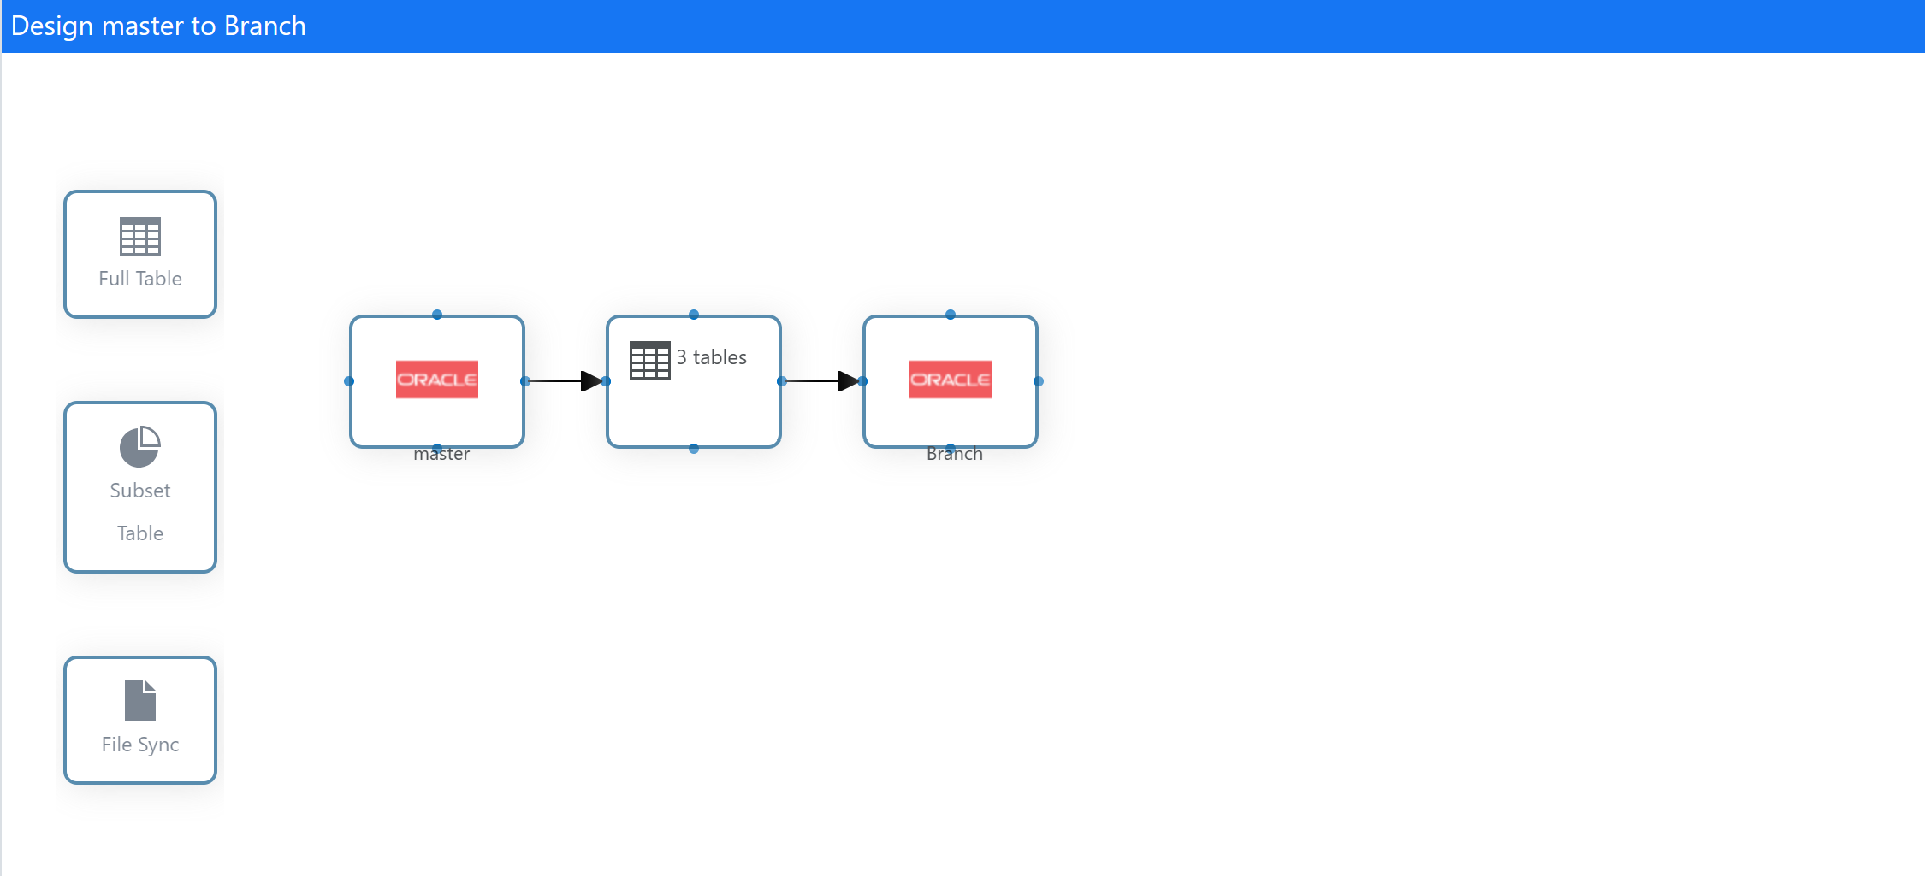
Replication Strategy
The replication strategy for the DRRDS-VEBR database will use a master-slave or master-master replication model. The master node will be located in the ICS headquarters, and the slave nodes will be located at branch offices around the world.

Slide 9

Demo

